Slide 1
VEHICLE ACCIDENT ALERT SYSTEM
USING GSM,GPS AND
ACCELEROMETER
NAMES
AADRISH SEN(13000322033) ABHIJIT SHIL(13000322035) ANUSUA CHANDA(13000322053) KRITTIKA GHATAK(13000322018) NIBEDITA GHOSH(13000322024) NILADRI GHOSH(13000322026)
PAPRI BHATTACHARJEE(13000322027)

Slide 2
ABSTRACT
In mountainous regions, accidents frequently occur due to low visibility, particularly in foggy conditions, and the absence of nearby assistance exacerbates the situation. To tackle this issue, we present a Vehicle Tracking, Safety, and Proximity Detection System designed to prevent accidents and enhance emergency response. The system combines GPS- based tracking with real-time environmental monitoring and advanced safety features. It not only provides data on vehicle location also integrates sensors to detect sudden gas leakages, alerting the driver to prevent potential hazards. Additionally, in foggy weather, the system uses proximity detection to identify vehicles ahead, warning drivers to maintain a safe distance and avoid collisions. In case of an accident, the system automatically relays the exact location to emergency services, ensuring a faster response. This comprehensive approach enhances both accident prevention and emergency aid, significantly improving road safety in foggy, mountainous terrains.
1

Slide 3
TABLE OF CONTENTS
SL.NO TOPIC
PAGE NO.
1
1.1
INTRODUCTION PROBLEM STATEMENT
3
4
1.2
2
OBJECTIVES REQUIREMENTS
4-5
6
3
CIRCUIT DIAGRAM
7
4
TESTING ON PROTEUS
9
5
WORKING EXPLANATION & Flowchart
TESTING
10-12
6
13-15
7
ADVANTAGES
16
8
LIMITATIONS
16
9
APPLICATIONS
17
10
CONCLUSION
18
2

Slide 4
1. INTRODUCTION
Vehicle accidents are one of the most leading causes of fatality. The time between an accident occurrence and the emergency medical personnel are dispatched to the accident location is the important factor in the survival rates after an accident. By eliminating that time between an accident occurrence and the first responders are dispatched to the scene decreases mortality rates so that we can save lives. One approach to eliminate that delay between accident occurrence and first responder dispatch is to use An Accident Alert and Vehicle Tracking System, which sense when a traffic accident is likely to occur and immediately notify emergency occurred. In this project, that system is described the main application of which is accident detection. In this system, initially the GPS continuously takes input data from the satellite and stores the latitude and longitude values. If we have to track the vehicle, we need to send a message to GSM device, by which it gets activated. It also gets activated by detecting accident on the accelerometer connected to Arduino Uno. Once GSM gets activated it takes the last received latitude and longitude positions values from the buffer and sends a message to a phone number. This system uses the things i.e.
Arduino, Accelerometer, GPS and GSM modules to detect traffic accidents.
An automatic alert system for vehicle accidents is introduced in this project. The proposed system which can detect accidents in significantly less time and sends the basic information to first aid center within a few seconds covering geographical coordinates, and also a link which directly opens in google maps. This alert message is sent to the central emergency dispatch server in a short time so that the emergency dispatch server will inform to the ambulances which are near to that location, which will help in saving the valuable lives.
3

Slide 5
1.1 PROBLEM STATEMENT
The unavailability of the precise methods for accident occurrence detection beside to a reliable locating tool with a quick reporting feature is the major problem under the research. The accidents are also increasing now days. Due to the delay in the arrival of ambulance to the accident spot it causes the loss of human life. So, it is necessary to take the accident victim to the hospital as early as possible.
1.2 OBJECTIVES
This vehicle tracking system takes input from GPS and send it through the GSM module to desired mobile/laptop using mobile communication. Vehicle Tracking System is one of the biggest technological advancements to track the activities of the vehicle. The security system uses Global Positioning System GPS, to find the location of the monitored or tracked vehicle and then uses satellite or radio systems to send to send the coordinates and the location data to the monitoring center. At monitoring center various software’s are used to plot the Vehicle on a map. In this way the Vehicle owners are able to track their vehicle on a real-time basis. Due to real-time tracking facility, vehicle tracking systems are becoming increasingly popular among owners of expensive vehicles To detect the vehicle accident and transmit the location of the accident to the rescue team and police center, so will get the exact location by the geographical
coordinates transmitted via message with the help of map.
4

Slide 6
In foggy areas such as mountainous regions, car accidents frequently occur due to poor visibility. To prevent such incidents, our system detects obstacles on the road, alerting drivers in real-time to avoid potential collisions. Additionally, the system is equipped with sensors that continuously monitor the vehicle's gas levels. In the event of a gas leak, the sensors will detect any abnormal drop in gas levels and immediately alert the driver, preventing hazardous situations such as fires or explosions. This dual safety mechanism aims to reduce accidents and ensure the safety of both the driver and passengers.
5

Slide 7
2. REQUIREMENTS
HARDWARE REQUIREMENTS:
Arduino UNO
ESP 32
Ultrasonic sensor (HC-SR04)
Gas sensor(MQ-7)
LCD display (16X2)
16X2 LCD I2C Interface Adapter
Buzzer
GSM module (Sim800L)
SOFTWARE REQUIREMENTS:
Arduino IDE
Proteus Professional Version 8.15
GPS module ( 7 SEMI GNSS L89 )
Accelerometer (adxl335-Triple axis)
Quadband GSM antenna
GPS antenna
Breadboard
Connecting wires
Battery 3.7V
USB cable
Soldering kit
Nuts and bolts Along with toolkit
6

Slide 8
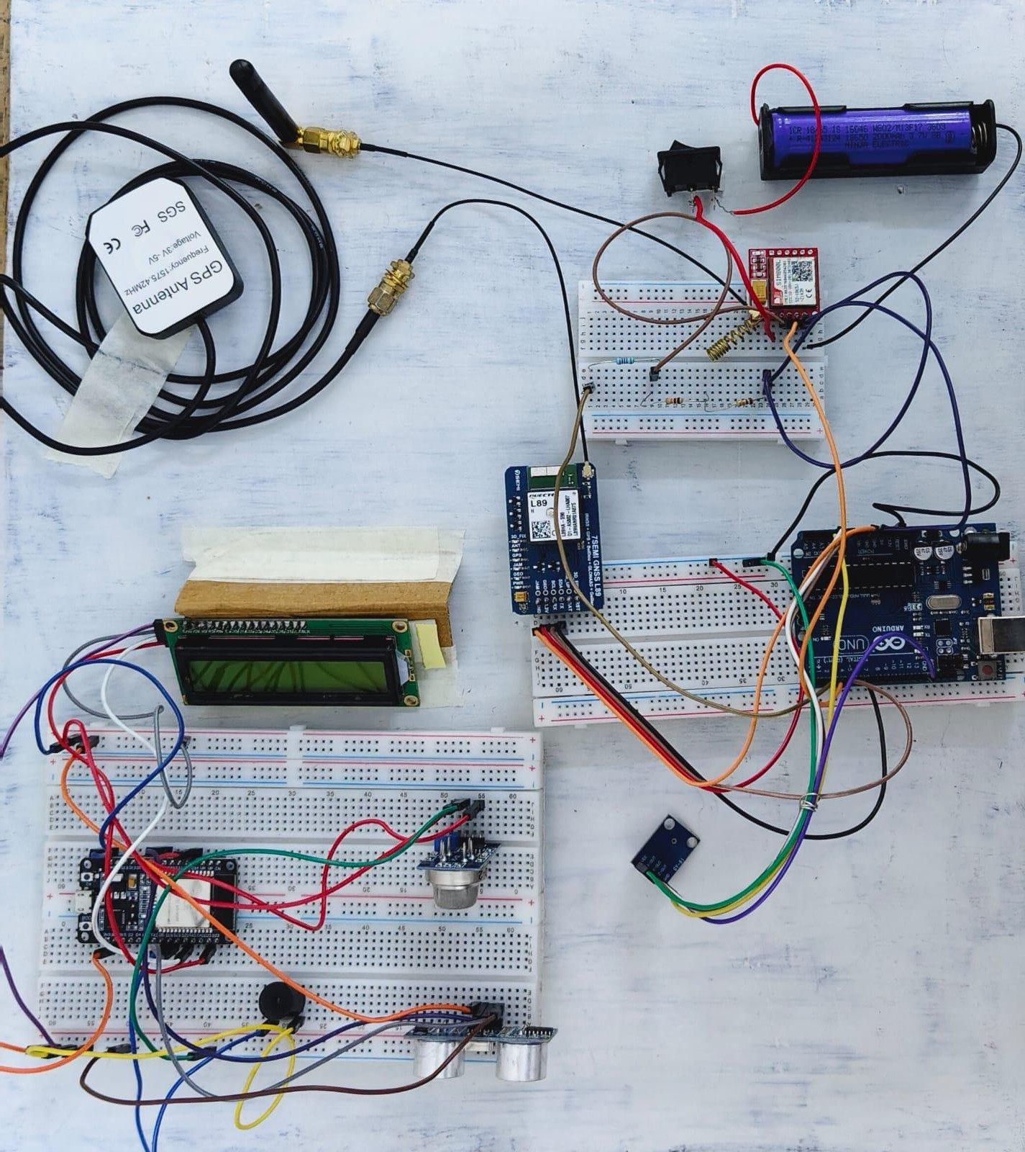
CIRCUIT DIAGRAM
7

Slide 9
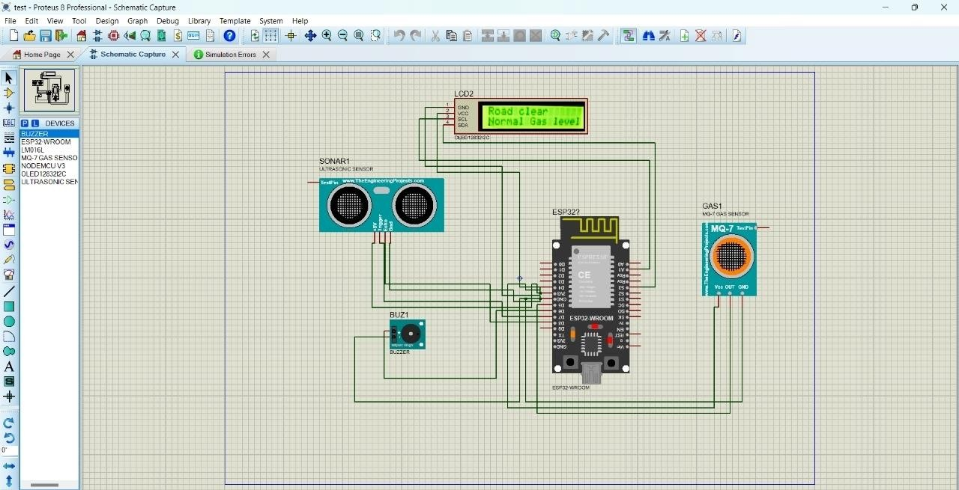
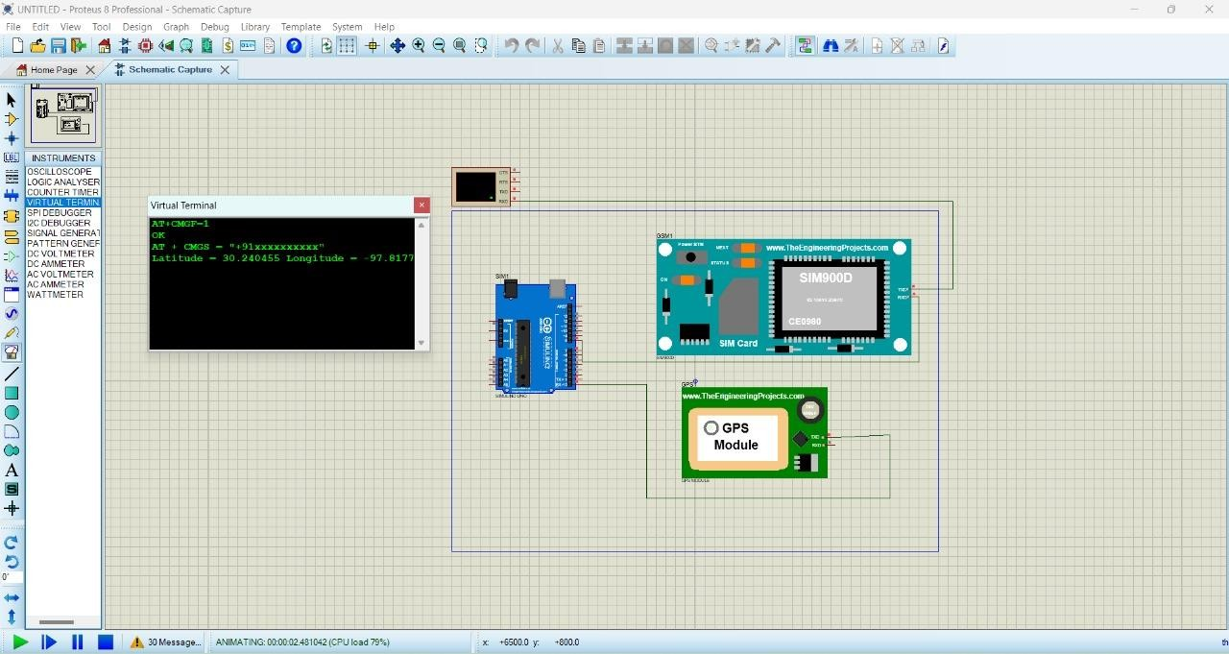
TESTING ON PROTEUS
8

Slide 10
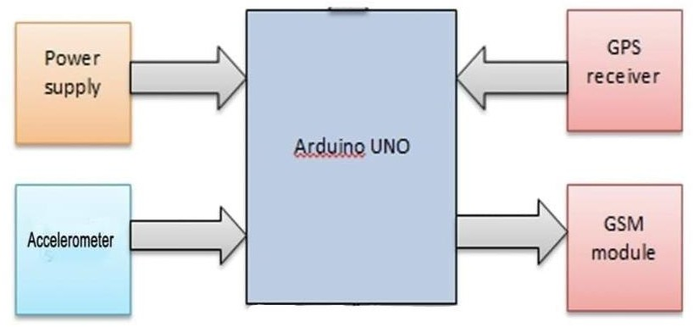
WORKING EXPLANATION
Here in the system block diagram shown in figure, Arduino is used as main microcontroller, this system is made for accident alert, the whole system is to be implemented in the vehicle itself. So, when the accident happens, the vibration senses the shock and send it to an Arduino microcontroller, at the same time, with GPS the latitude and longitude of that particular location is obtained, and with that the exact location of the accident site is determined. And here, GSM module SIM800L is interfaced with microcontroller. So that, when accident happens, the SMS will be sending automatically to the particular numbers which would be entered in the code. Accelerometer will check shock intensity and the validity of sending message.
When we are ready with our hardware after programming, we can install it in our vehicle and power it up. Now whenever there is an accident, the car gets tilt and accelerometer changes its axis values.
These values are read by Arduino and checks if any change occurs in any axis.
If any change occurs then, using the GPS module we obtain the co-ordinates of the exact accident location and send SMS to the predefined number to the police or ambulance or family member with the location coordinates. The message also contains a Google Map link to the accident location, so that location can be easily tracked. When we receive the message then we only need to click the link and we will redirect to the Google map and then we can see the exact location of the
vehicle.
9

Slide 11
FLOWCHART
Part 1
START
Ultrasonic Sensor & Smoke Sensor Sensor
Obstacle
Detected
NO
YES
Smoke
Detected
“Road Clear”
On LCD
YES
NO
“Obstracle Detected”
On LCD
Buzzer Off
&
“Normal Gas level”
On LCD
Buzzer On
&
“gas warning”
On LCD

Slide 12
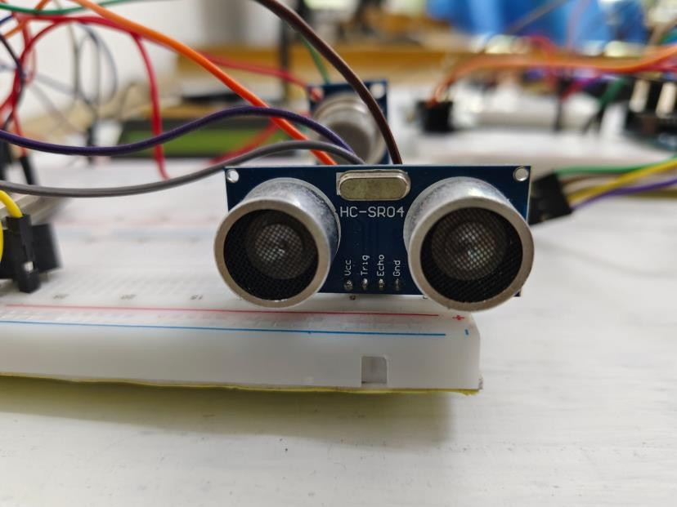
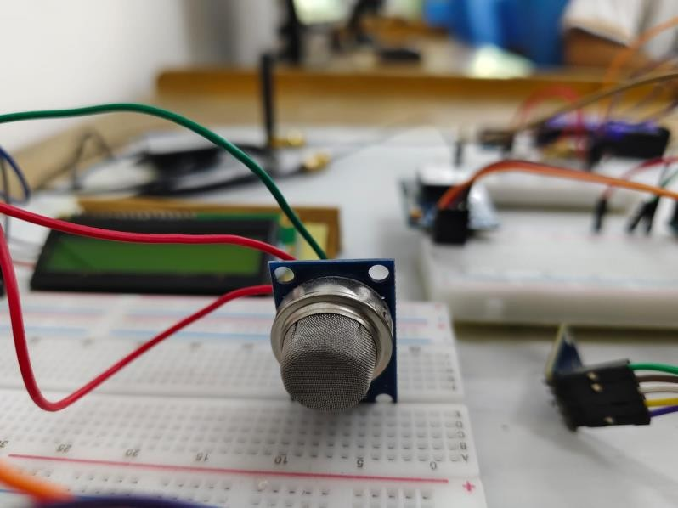
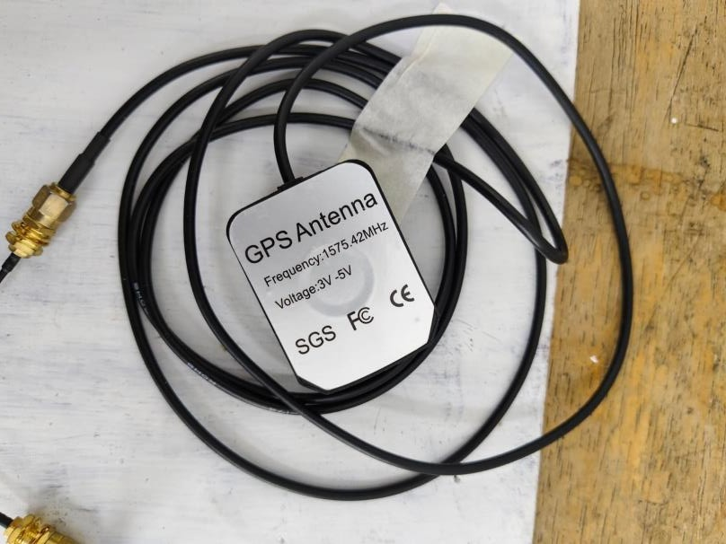
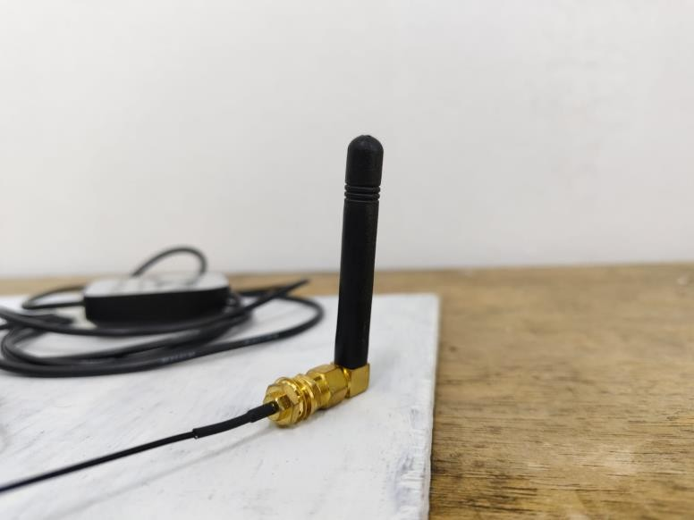
TESTING
RESULTS:
The proposed system is developed to provide the information about the accident occur and the location of the accident. It helps to easily provide the assistant and help to the victim of the accident. This system uses GPS module to locate the vehicle. GSM is used to provide the information of accident. The results of the proposed systems are satisfactory.
SENSORS
ULTRASONIC SENSOR
MQ7 GAS SESNOR
GPS ANTENNA
QUADBAND ANTENNA
10

Slide 13
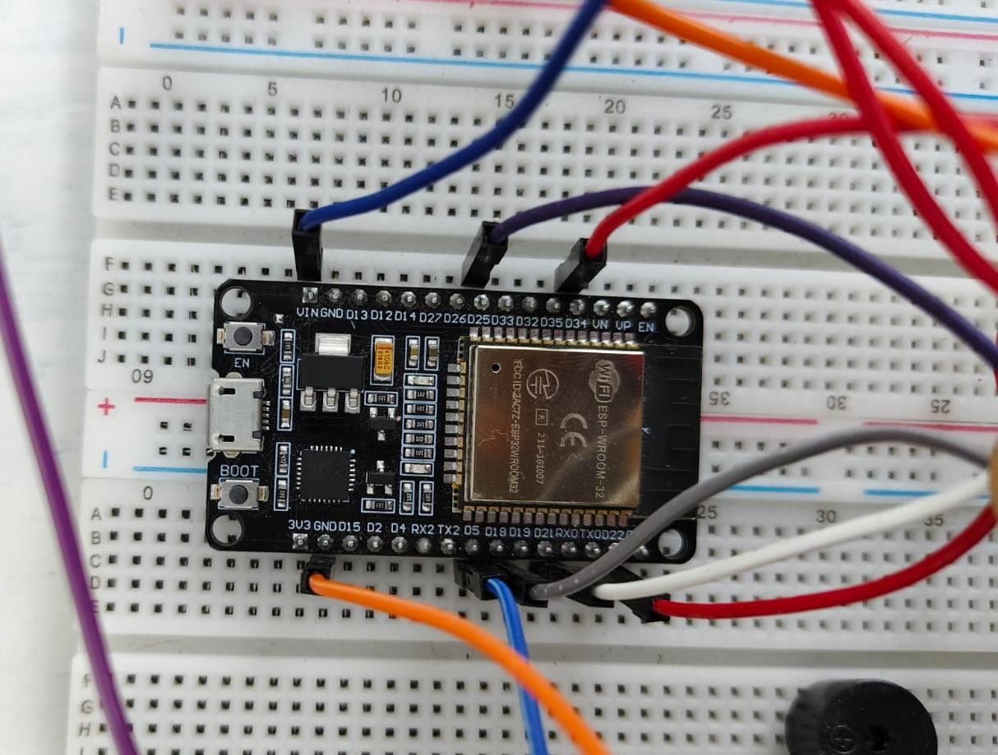
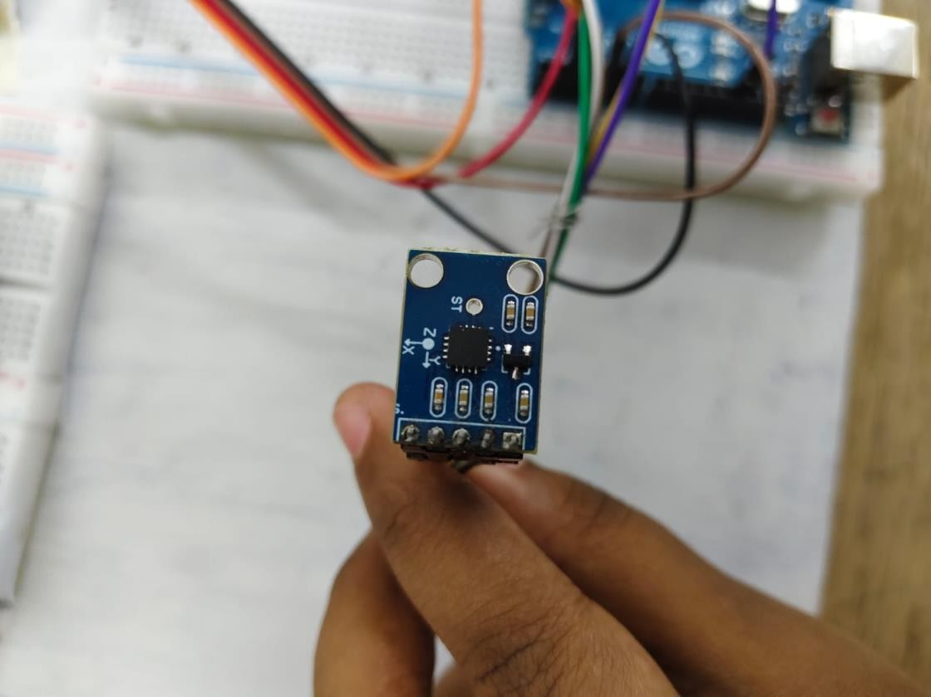
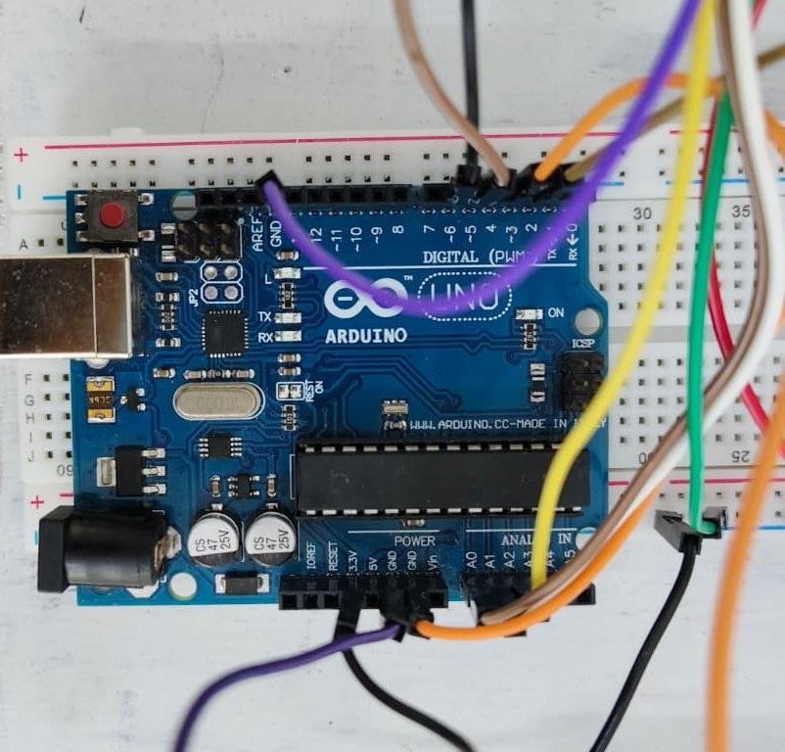
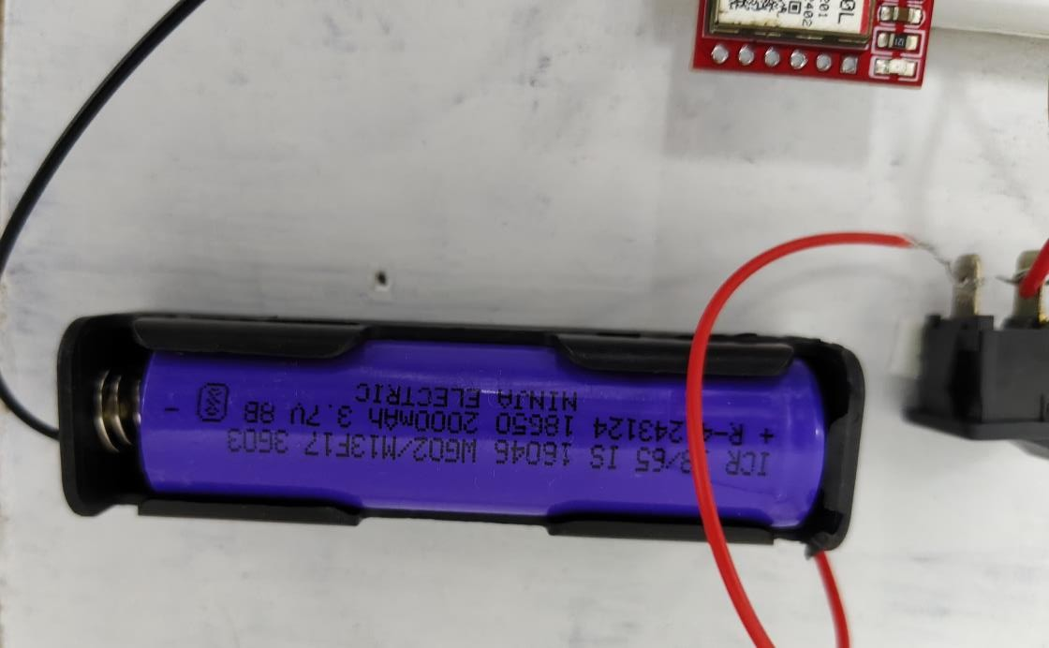
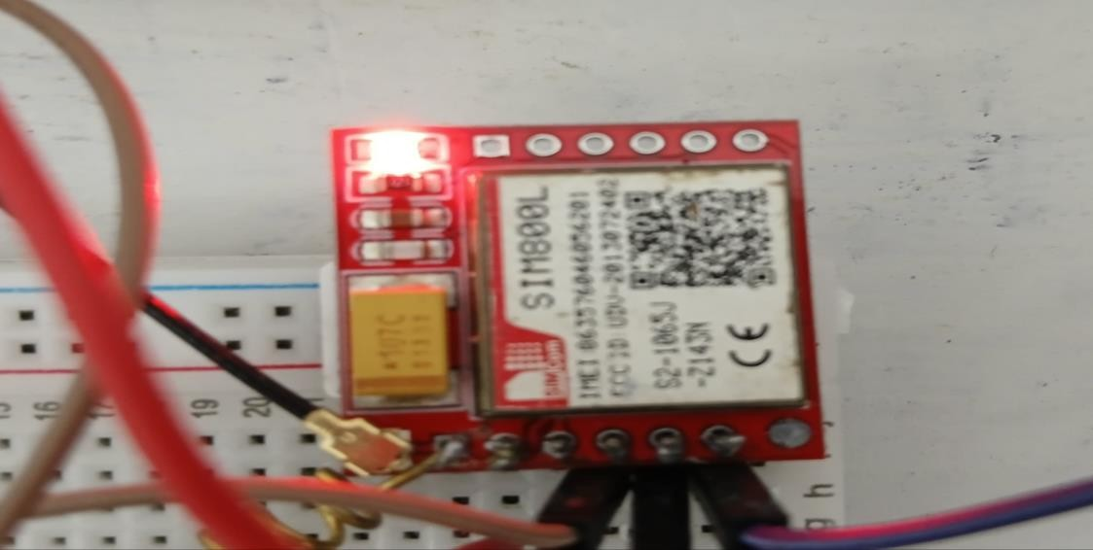
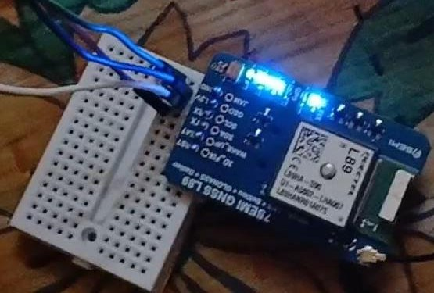
ESP32
ADXL 335
ARDUINO UNO
3.7 V BATTERY
GSM MODULE
GNSS MODULE
11

Slide 14
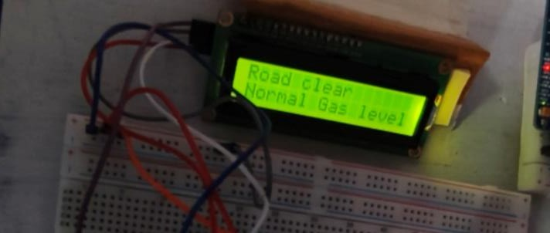
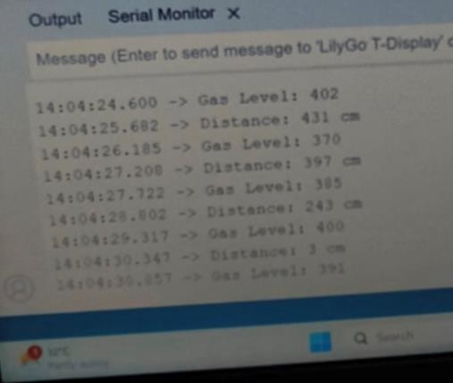
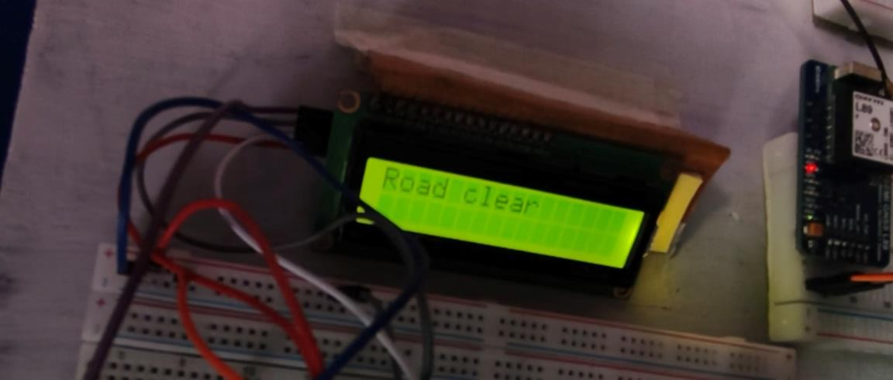
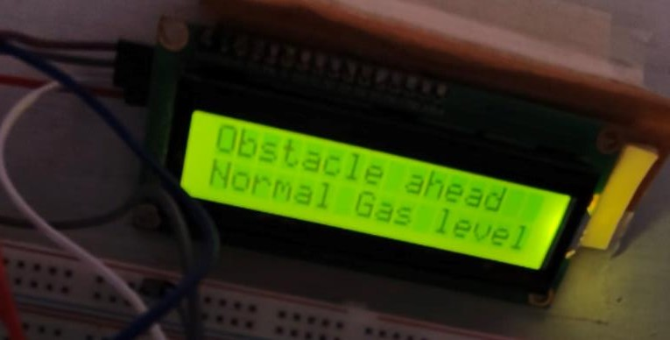
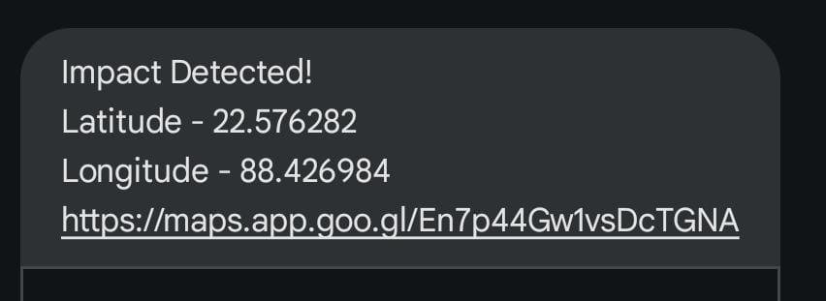
GAS LEVEL DETECTION
OBSTACLE DETECTION
ACCIDENT ALERT MESSAGE IS RECEIVED WITH LATITUDE AND LONGITUDE USING GSM AND GPS MODULE RESPECTIVELY
12

Slide 15
ADVANTAGES
Here are the advantages of our system:
Immediate Alerts: Sends instant SMS with GPS location for quick emergency response.
Hazard Detection: Monitors gas leaks and obstacles to prevent accidents.
Integrated Safety: Combines multiple safety features for comprehensive protection.
Cost-Effective: Affordable and customizable with widely available components.
Road Safety: Enhances safety with proactive measures and data logging for analysis.
LIMITATIONS
Some potential limitations of our accident alert system:
Signal Dependence: Requires a stable GSM network for SMS alerts, which may be unreliable in remote areas.
Power Consumption: Continuous operation of multiple sensors can drain the battery quickly.
False Positives: Gas and obstacle sensors might trigger false alarms in non- critical situations.
Limited Processing Power: Arduino Uno has limited processing capacity, which may restrict the system's scalability.
Maintenance: Sensors and modules may require regular calibration and maintenance for accurate performance.
13

Slide 16
APPLICATIONS
Here are some real-world applications of our accident alert system:
Ridesharing Services (e.g., Uber, Lyft): Enhances passenger safety by
automatically notifying the company and emergency contacts in case of an accident.
Commercial Trucking: Helps logistics companies monitor their fleets, ensuring quick response to accidents and minimizing downtime.
School Buses: Ensures the safety of children by alerting school authorities and parents about accidents or hazardous conditions in real time.
Mining and Construction Vehicles: Monitors the safety of vehicles in hazardous environments, reducing the risk of accidents and improving emergency response.
Ambulances and Emergency Vehicles: Provides precise location data in case of accidents, enabling faster assistance and reducing the risk of additional incidents during emergency operations.
Public Transport Systems: Enhances safety in buses and trains by automatically sending alerts to central control rooms in the event of accidents or gas leaks.
14

Slide 17
CONCLUSION
Our accident alert system is a robust and versatile solution that significantly enhances vehicle safety by integrating GSM, GPS, gas detection, and obstacle warning features. It offers immediate accident alerts, comprehensive hazard monitoring, and proactive safety measures, making it a valuable tool for reducing the impact of road accidents and improving emergency response times.
POTENTIAL FUTURE SCOPE
Vehicle-to-Vehicle (V2V) Communication: Expanding the system to include V2V communication could enable vehicles to share safety information, further preventing accidents.
Cloud Connectivity: Integrating with cloud services could enable real-time data analysis and remote monitoring, providing valuable insights for traffic management and accident prevention.
Mobile App Interface: Developing a mobile app could allow users to receive alerts, track vehicle status, and access accident history directly from their
smartphones.
15

